Slide 1
Simple WebApp: A simple website with GUI with topics of personal choices.
Members:
Julián Lilloy
Ernest Wgoke
Olabisi

Slide 2
Invoice Manager GUI: A Python-Tkinter & MySQL Project
Member:
Julián Lilloy

Slide 3
INDEX
Structure of the presentation:
Introduction
Core
Demo
Conclusions

Slide 4
Introduction
Why an invoice App? What for? Which problem does it solve? For whom does it solve this problem?
Display of the every day information of a company into a database from which you can acces and make dashboards

Slide 5
Plan
The idea was to create an Invoice Manager in the form of a Simple Webapp in a group
Stick to the idea in a 3 steps plan:
1 Create a an app that would take input from the terminal and would insert the output into a database
2 Scale up to a GUI throughout Tkinter
3 Create a Simple Webapp to work as a frontend

Slide 6




Elements of the project
Python
MySQL
Tkinter
ChatGPT

Slide 7
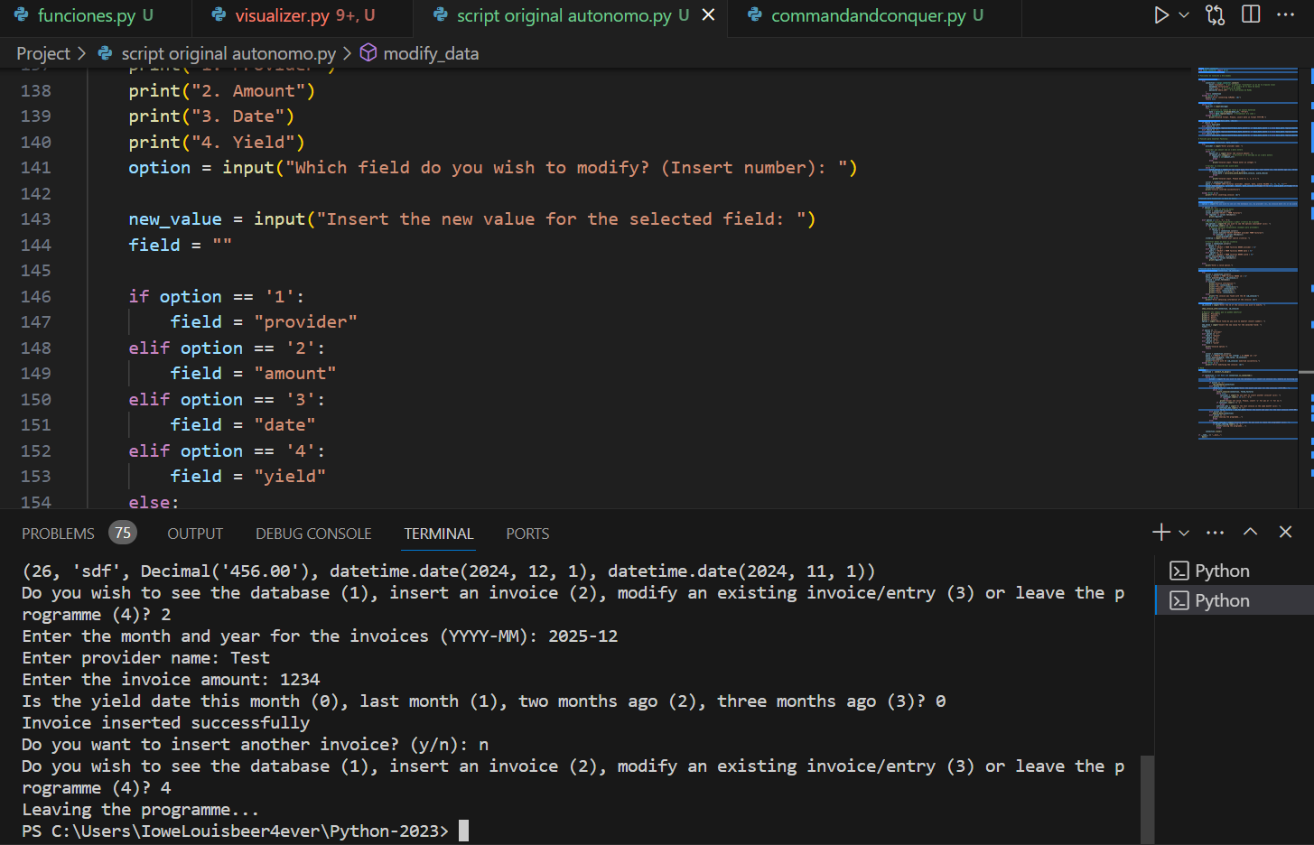
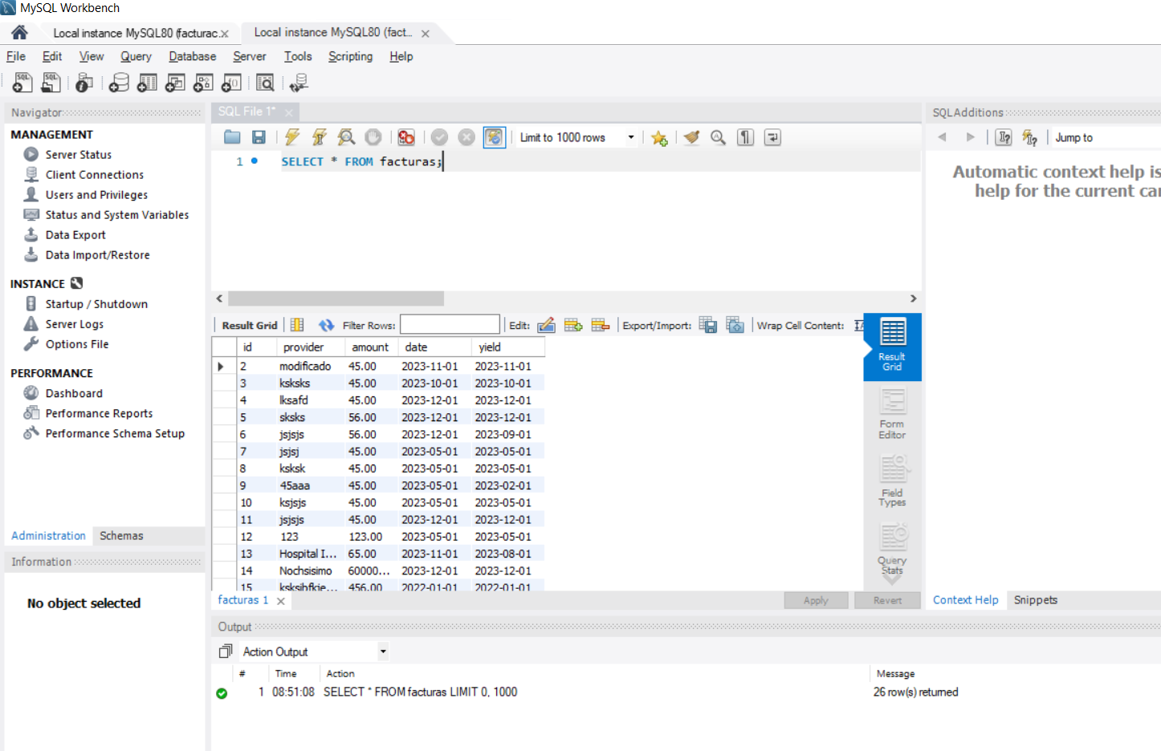
First Step

Slide 8
Second Step
Terminal Input Based programme to GUI Interface
One Code with all the functions
Functions.py
One file for the functions and
connections to the database
Visualizer.py
One file for the visualization

Slide 9
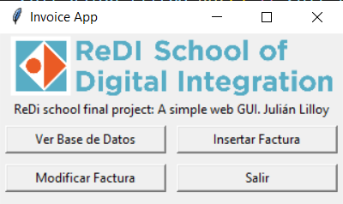
Demo: The programme

Slide 10
Short conclusions (1 min):
How would you expand this project if you had more time?
○ Which challenges did you as a team? How did you solve them? What did you learn?

